Slide 1
Object Oriented Systems Analysis & Design using Java & UML
Lecture 3 : Inheritance - Revision

Slide 2
Lecture Contents
Inheritance
  Super Class (parent class)
  Subclass (child class)
  Generalization
  Specialization
  Java’s Object Hierarchy
Lecturer: Orla McMahon

Slide 3
Inheritance
By making use of Inheritance we can create new classes from already existing ones by extending them with new attributes and methods.
Using inheritance we can express object relationships such as “an athlete is a person” or “a book is a document”.
Lecturer: Orla McMahon

Slide 4
Inheritance
In Java inheritance is introduced by creating subclasses of already existing classes.
Subclasses are created by using the extends keyword when defining a new subclass.
By using inheritance we can create objects that are only partly equal to other objects. (this will become more apparent later on!)
The best way to understand inheritance is to have a look at an example program.
Lecturer: Orla McMahon

Slide 5
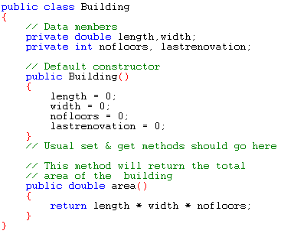
Inheritance
The class above models a general object called building.
Lecturer: Orla McMahon

Slide 6
Inheritance
The class has data members which model the buildings physical attributes, length, width, and number of floors.
It also has a data member which stores the year in which the building was last renovated.
I have omitted the usual set and get methods as we will assume that they will be written at some stage.
Lastly the class has a method called area which is a general thing that can be done with all types of buildings.
Lecturer: Orla McMahon

Slide 7
Inheritance
Lets suppose for a moment that we wanted to model a specific type of building, lets say a house that people could live in.
A house
  has a length, width and a number of floors
  may have been renovated
  has an area which is given by length*width*No. floors
  will usually be insulated
  will usually have a number of bedrooms
We already have a class that models some of the above attributes and behaviours
So why not extend our building class to produce a house class.
Lecturer: Orla McMahon

Slide 8
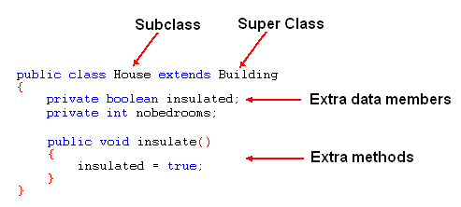
Inheritance
Lets have a look at the code to do this
Lecturer: Orla McMahon

Slide 9
Inheritance
Note that when we define a subclass we use the keyword “extends” .
The following template can be used when defining a subclass
class subclass_name extends superclass_name
{
// declarations of additional instance variables
// definitions of additional methods
}
Lecturer: Orla McMahon

Slide 10
Inheritance
An object of type house will have 6 data members
  length (inherited from Building)
  width “ “
  nofloors “ “
  lastrenovation “ “
  insulated ( own data member )
  nobedrooms “ “
Lecturer: Orla McMahon

Slide 11
Inheritance
An object of type house will have the following methods
  setLength getLength (inherited from building)
  setWidth getWidth “ “
  setNoFloors getNoFloors “ “
  setLastRen getLastRen “ “
  area “ “
  setInsulated getInsulated ( own method )
  setNoBedRooms getNoBedRooms “ “
  Insulate “ “
Lecturer: Orla McMahon

Slide 12
Inheritance
A class that is a subclass can in turn be a superclass
  (in fact any class in Java is a potential superclass)
For example we can define a class that models houses with several flats.
We can extend our house class and add a data member to store the number of flats in the building.
The next slide shows an example of this class.
Lecturer: Orla McMahon

Slide 13
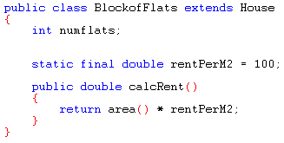
Inheritance
As each flat will be rented, we have included a constant variable called rentPerM2 so that rent can be calculated.
A calcRent method has also been added so that we can call it to return the amount of rent owed.
Lecturer: Orla McMahon
Notes:
When a variable is declared with the static keyword, its called a “class variable”. All instances share the same copy of the variable. A class variable can be accessed directly with the class, without the need to create a instance..
Without the “static” keyword, it's called “instance variable”, and each instance of the class has its own copy of the variable.

Slide 14
Inheritance
We can think of inheritance as a kind of family tree for classes where each child class inherits the data members and methods from its parent.
Any class that has no descendants is called a leaf class
A class that has descendants will itself be a parent and can be seen as a branch of the family tree.
Lecturer: Orla McMahon

Slide 15
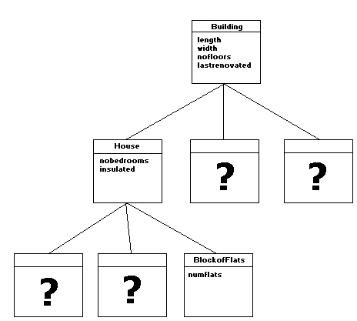
Inheritance
Lecturer: Orla McMahon

Slide 16

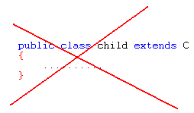
Inheritance
In Java it is possible to create a class from which there can be no subclasses create. This is achieved by using the keyword final when declaring a class.
This means that the class C cannot be extended.
Lecturer: Orla McMahon

Slide 17
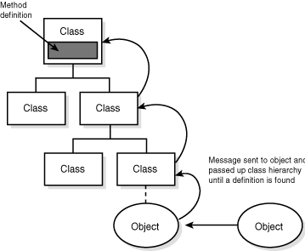
Inheritance
So what happens when you call an inherited method such as area ? How does Java know where to find the method ?
Java starts at the bottom of the hierarchy and works its way upwards towards the root until it finds a method that matches the call.
Lecturer: Orla McMahon

Slide 18
Inheritance
Generalisation
  Generalisation is when we take two classes with similar attributes and generalise to give a superclass.
  For example book and magazine might give literature
  Captures similarities between classes
Specialisation
  This is when take an existing class and create subclasses by extending it.
  For example when we create a House from the Building class we were specialising
  Captures differences between similar classes
Lecturer: Orla McMahon
Notes:
Ref. p/68/69 TforT

